Slide 1
Application Building
We Build an HTML page to take the URL as a text and upon clicking on the button for submission it has to redirect to the URL for “y_predict” which returns if the URL given is phishing or safe. The output is to be then displayed on the page. The HTML pages are put under the templates folder and any style sheets if present is kept in the static folder.

Slide 2
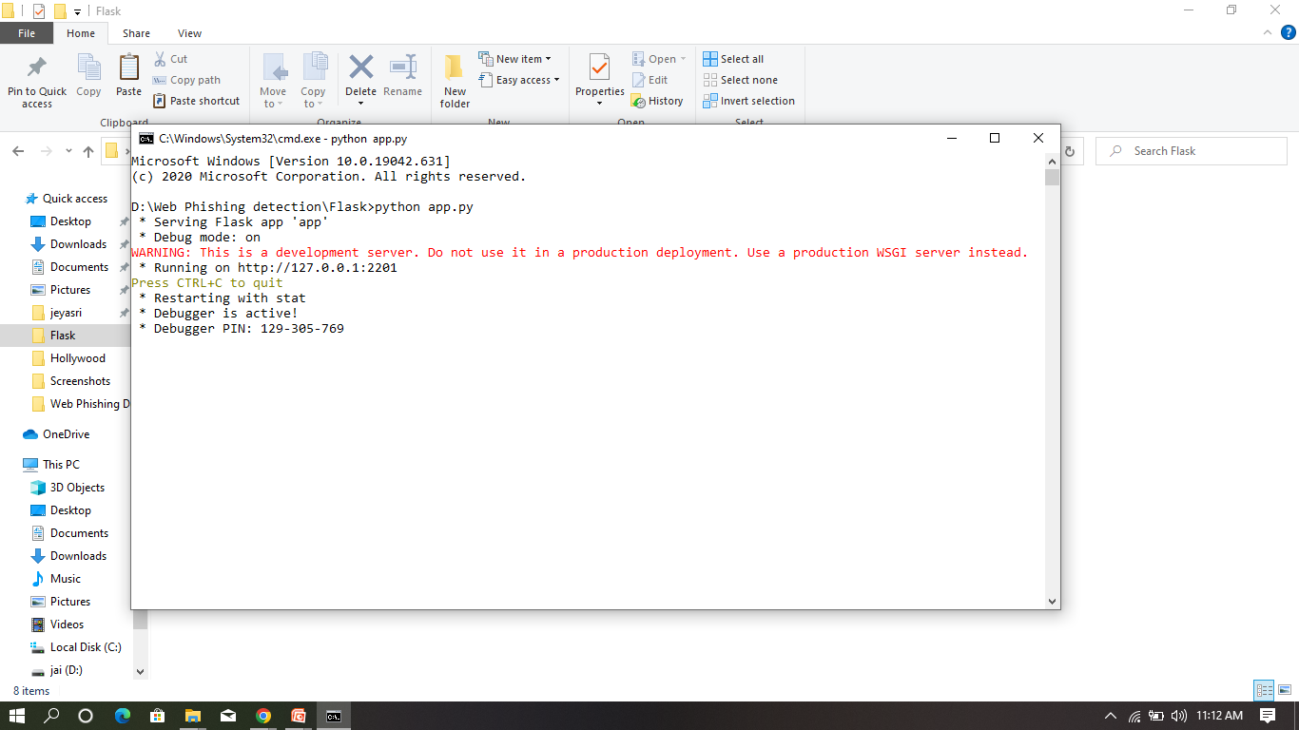

Slide 3
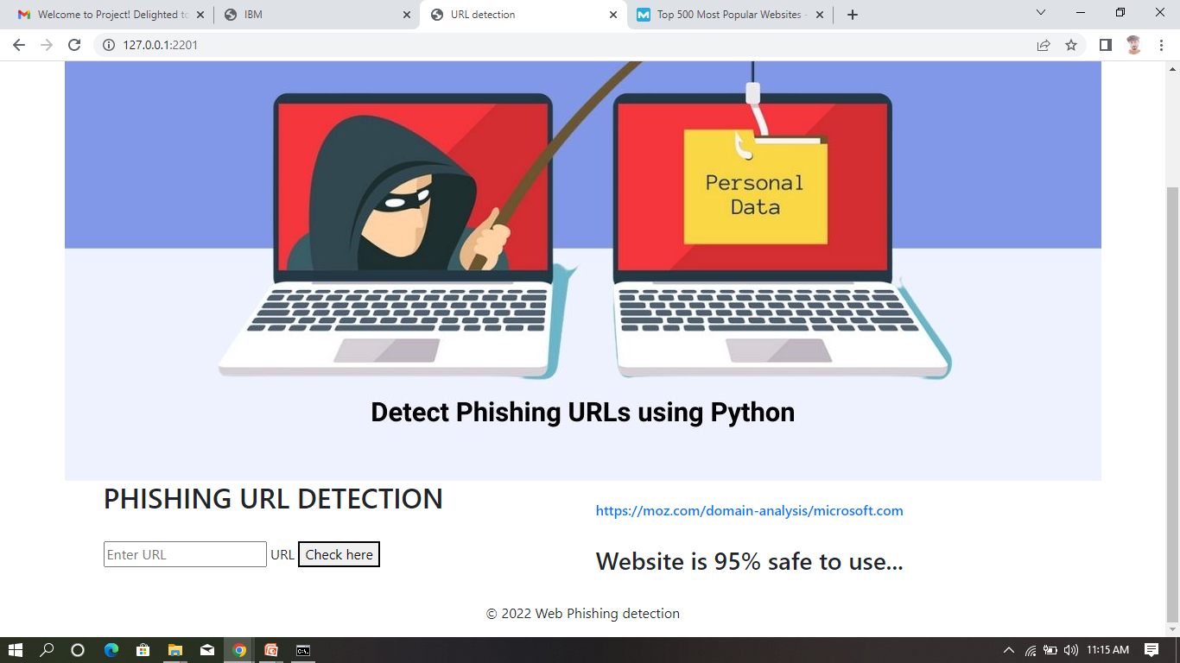

Slide 4


